Slide 1
Unit 13 Inductors
Part B : Charging and Discharging Processes of Inductors

Slide 2
What will you learn?
The charging process of inductor.
The discharging process of inductor.

Slide 3



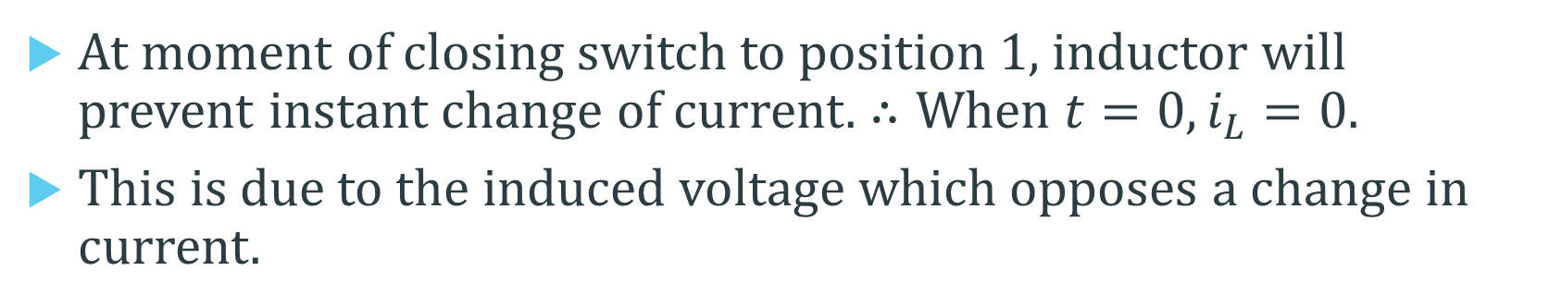




Charging or Energizing an Inductor
RL (Resistor-Inductor) TIME CONSTANT (τ, tau)
$$i_{L}$$
$$R$$
+
$$v_{R}$$
−
+
$$V_{S}$$
$$L$$
$$v_{L}$$
$$R$$
−
At moment of closing switch to position 1, inductor will prevent instant change of current. $∴When t=0, i_{L}=0.$
This is due to the induced voltage which opposes a change in current.

Slide 4
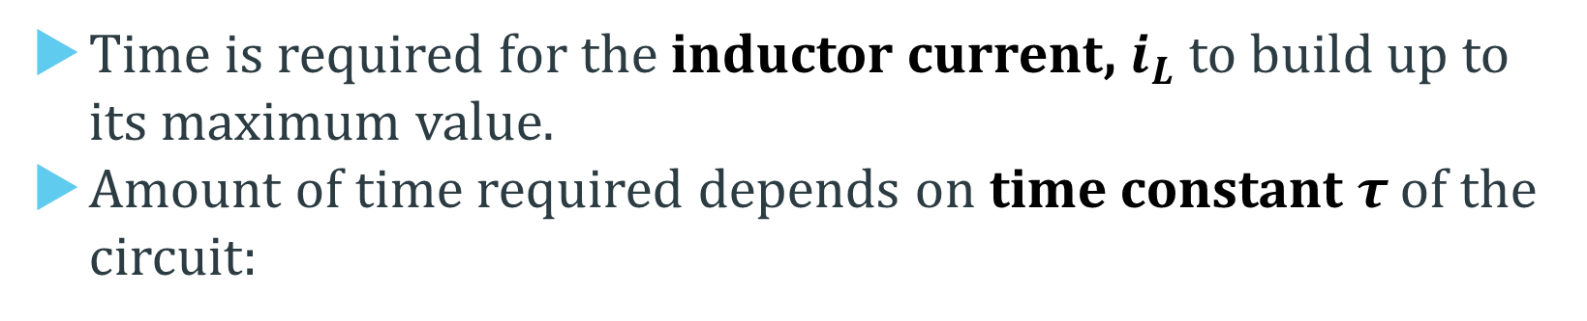
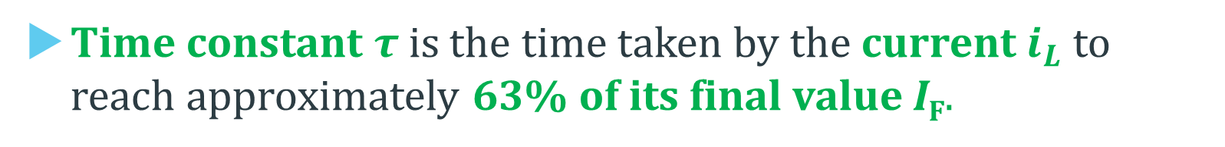
Charging or Energizing an Inductor
Time is required for the inductor current, $i_{L}$ to build up to its maximum value.
Amount of time required depends on time constant τ of the circuit:
τ is the time constant (in seconds, s)
R is the circuit resistance (in ohms, Ω)
L is the circuit inductance (in henries, H)
Time constant τ is the time taken by the current $i_{L}$ to reach approximately 63% of its final value I_{F}.

Slide 5
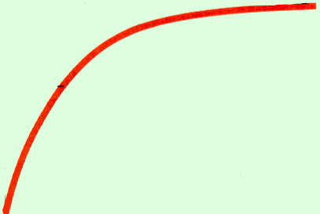


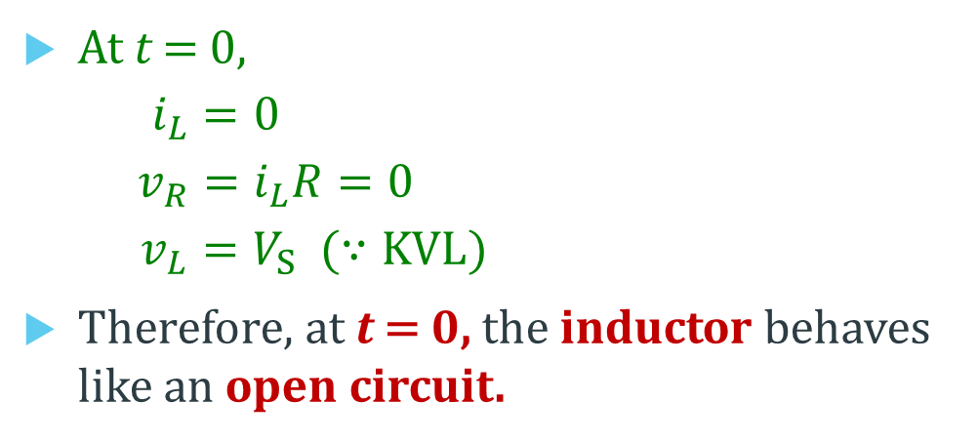






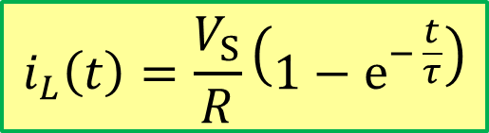
RL Charging Circuit
$$i_{L}\left(t\right)=\frac{V_{S}}{R}\left(1−e^{− \frac{t}{τ}}\right)$$
$$i_{L}(t)$$
I_{F} (final current value)
I_{F}
0.63 I_{F}
Current Rise
0
τ
t
At t = 0,
$i_{L}=0$
$v_{R}=i_{L}R=0$
$v_{L}=V_{S} (∵KVL)$
Therefore, at t = 0, the inductor behaves like an open circuit.
$$i_{L}$$
$$R$$
+
$$v_{R}$$
−
+
$$V_{S}$$
$$L$$
$$v_{L}$$
$$R$$
−

Slide 6
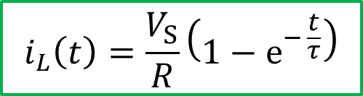
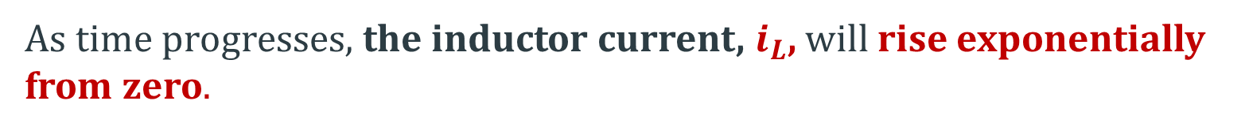
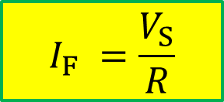
RL Charging Circuit
As time progresses, the inductor current, $i_{L}$, will rise exponentially from zero.
$$i_{L}\left(t\right)=\frac{V_{S}}{R}\left(1−e^{− \frac{t}{τ}}\right)$$
At time, t = τ, the current will reach approximately 63% of its final (maximum) value, I_{F} .
$$i_{L}\left(τ\right)=\frac{V_{S}}{R}\left(1−e^{− \frac{τ}{τ}}\right)=\frac{V_{S}}{R}\left(1−e^{−1}\right)≈0.63\frac{V_{S}}{R}=0.63 I_{F}$$
$$I_{F} =\frac{V_{S}}{R}$$
At time, t = 5τ, the current will reach about 99% of the maximum value, I_{F} = Vs/R.
$$i_{L}\left(5τ\right)=\frac{V_{S}}{R}\left(1−e^{− \frac{5τ}{τ}}\right)=\frac{V_{S}}{R}\left(1−e^{−5}\right)≈0.99\frac{V_{S}}{R}=99\% I_{F}$$

Slide 7

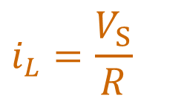




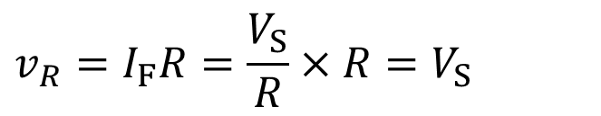


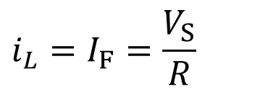



RL Charging Circuit
5τ is usually considered as the time taken by the current to reach its final or steady state value.
$$i_{L}$$
$$R$$
At steady state,
$$i_{L}=\frac{V_{S}}{R}$$
+
$$v_{R}$$
−
$$i_{L}=I_{F}=\frac{V_{S}}{R}$$
+
$$V_{S}$$
$$L$$
$$v_{L}$$
$$R$$
−
$$v_{R}=I_{F}R=\frac{V_{S}}{R}×R=V_{S}$$
$$v_{R}=V_{S}$$
$$v_{L}=0 V$$
$$By KVL, { v}_{L}=V_{S}−v_{R}=V_{S}−V_{S}=0$$
Thus, at steady-state (t = ∞), inductor behaves like a short circuit.

Slide 8
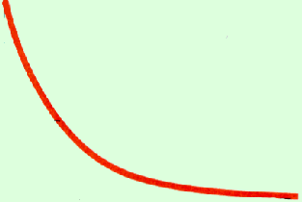

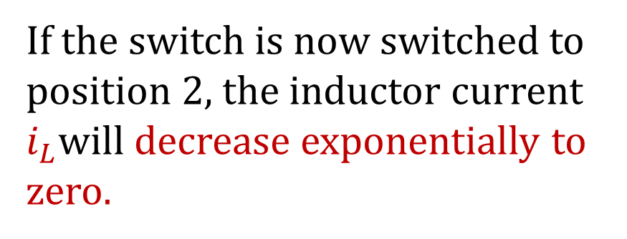


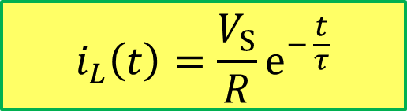



RL Discharging Circuit
If the switch is now switched to position 2, the inductor current $i_{L}$will decrease exponentially to zero.
$$i_{L}$$
V_{S}
$$v_{L}$$
$$R$$
Assume that it takes 0 sec to switch from position 1 to position 2.
$$i_{L}(t)$$
$$\frac{V_{S}}{R}$$
$$i_{L}\left(t\right)=\frac{V_{S}}{R}e^{− \frac{t}{τ}}$$
$$0.37\frac{V_{S}}{R}$$
Current Decay
0
τ
t

Slide 9
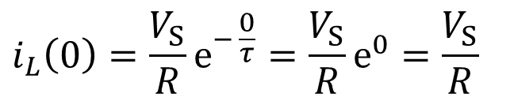





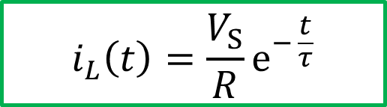

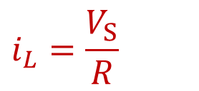
RL Discharging Circuit
$$i_{L}$$
$$i_{L}(t)$$
$$v_{L}$$
$$R$$
V_{S}
$$\frac{V_{S}}{R}$$
$$i_{L}\left(t\right)=\frac{V_{S}}{R}e^{− \frac{t}{τ}}$$
$$0.37\frac{V_{S}}{R}$$
Current Decay
0
τ
t
$$i_{L}=\frac{V_{S}}{R}$$
At the instant of switching to position 2, $t=0$,
$$i_{L}\left(0\right)=\frac{V_{S}}{R}e^{− \frac{0}{τ}}=\frac{V_{S}}{R}e^{0}=\frac{V_{S}}{R}$$

Slide 10
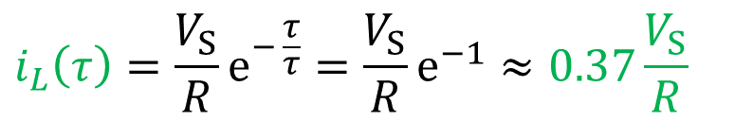
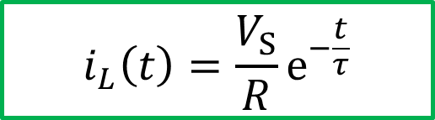
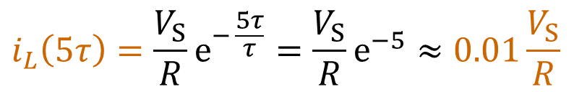
RL Discharging Circuit
$$i_{L}(t)$$
$$\frac{V_{S}}{R}$$
$$i_{L}\left(t\right)=\frac{V_{S}}{R}e^{−\frac{t}{τ}}$$
Current Decay
5τ is usually considered as the time taken by the current to reduce to 0 A.
$$0.37\frac{V_{S}}{R}$$
0
τ
5τ
t
At time, t = τ, the current drops by 64% from its initial maximum value.
At time, t = 5τ, the current drops by 99% from its initial maximum value.
$$i_{L}\left(τ\right)=\frac{V_{S}}{R}e^{− \frac{τ}{τ}}=\frac{V_{S}}{R}e^{−1}≈0.37\frac{V_{S}}{R}$$
$$i_{L}\left(5τ\right)=\frac{V_{S}}{R}e^{− \frac{5τ}{τ}}=\frac{V_{S}}{R}e^{−5}≈0.01\frac{V_{S}}{R}$$

Slide 11
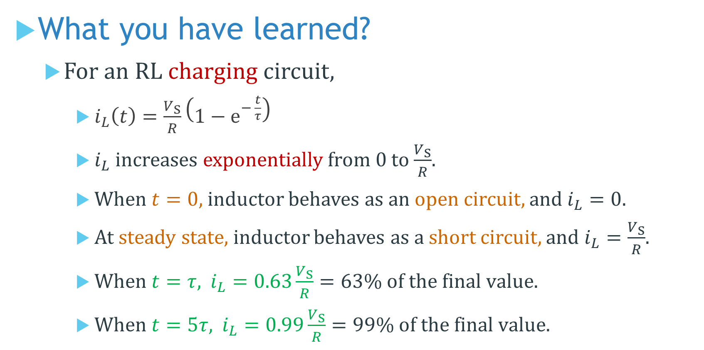
What you have learned?
For an RL charging circuit,
$i_{L}\left(t\right)=\frac{V_{S}}{R}\left(1−e^{− \frac{t}{τ}}\right)$
$i_{L}$ increases exponentially from 0 to $\frac{V_{S}}{R}$.
When $t=0$, inductor behaves as an open circuit, and $i_{L}=0$.
At steady state, inductor behaves as a short circuit, and $i_{L}=\frac{V_{S}}{R}$.
When $t=τ$, $i_{L}=0.63\frac{V_{S}}{R}=63\% of the final value.$
When $t=5τ$, $i_{L}=0.99\frac{V_{S}}{R}=99\% of the final value.$

Slide 12
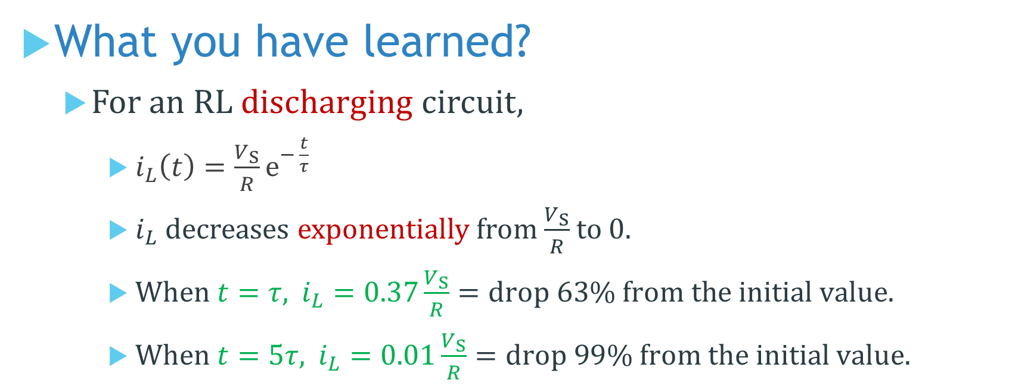
What you have learned?
For an RL discharging circuit,
$i_{L}\left(t\right)=\frac{V_{S}}{R}e^{− \frac{t}{τ}}$
$i_{L}$ decreases exponentially from $\frac{V_{S}}{R}$ to 0.
When $t=τ$, $i_{L}=0.37\frac{V_{S}}{R}=drop 63\% from the initial value.$
When $t=5τ$, $i_{L}=0.01\frac{V_{S}}{R}=drop 99\% from the initial value.$

Slide 13
Coming Up Next
Transformer

